Slide 1
Week 1-2
Initial Setup

Slide 2
MIRL LAB Honours Project Bi-Weekly Update
MARL Crazyflie
Michael O’Sullivan, Aydin Yalcinkaya
Using MARL to learn safe take-off and hover policies for Crazyflie drones
CrazyFlie, MuJuCo, Gymnasium, PyTorch

Slide 3
Progress Recap
Goal: Implementing MARL algorithms for safe hovering and navigation on Crazyflie drones
Progress
  Base environment for training a single drone to hover at a target
  Single agent PPO-Clip applied to the target hover environment

Slide 4
Progress Since Last Meeting
Gymnasium environment set up for a basic hover task
MuJoCo simulation that renders the drone and target
PPO-Clip applied to a single drone for the hover task
Results
  Semi-successful policy resulting in imperfect hover behaviour
Challenges
  Tuning the environment and/or policy to optimize reward
    → Minimize oscillation about the target
  Inconsistent convergence on behaviour
    E.g. sometimes learns to oscillate target, stay on ground, or fly high up

Slide 5
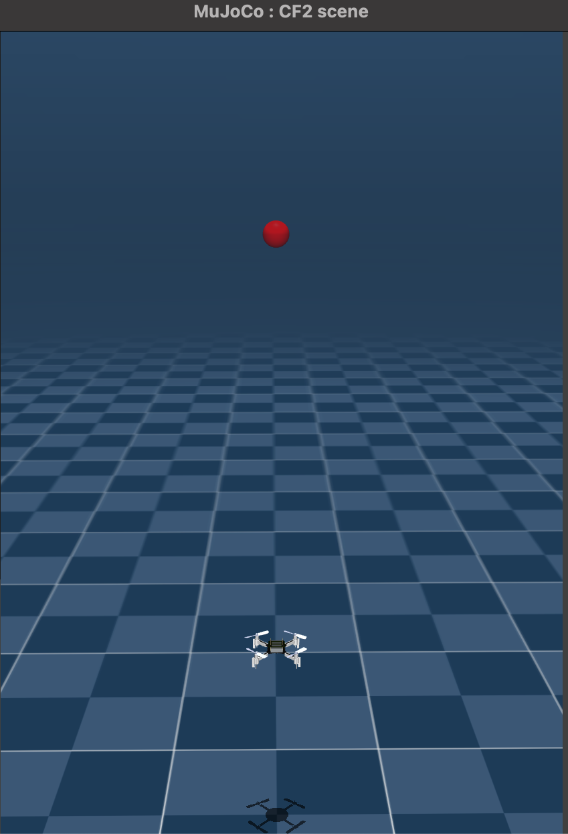
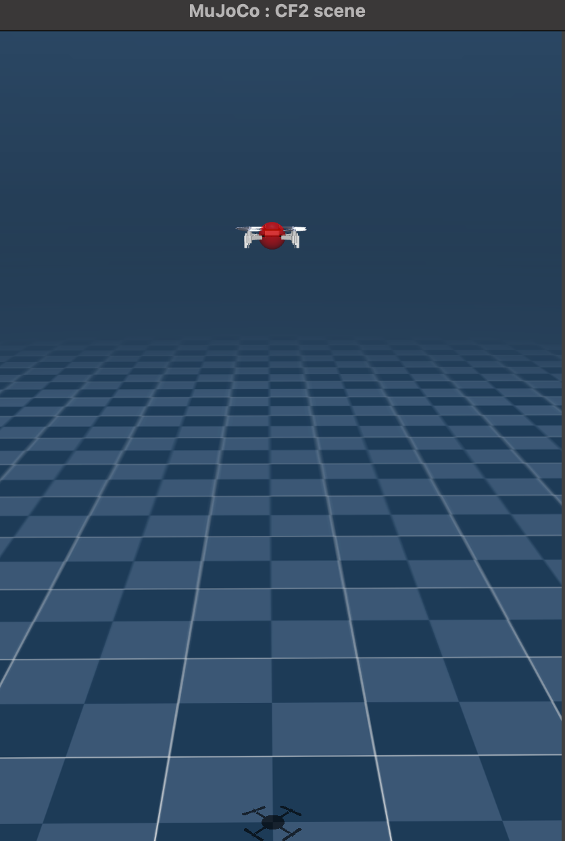
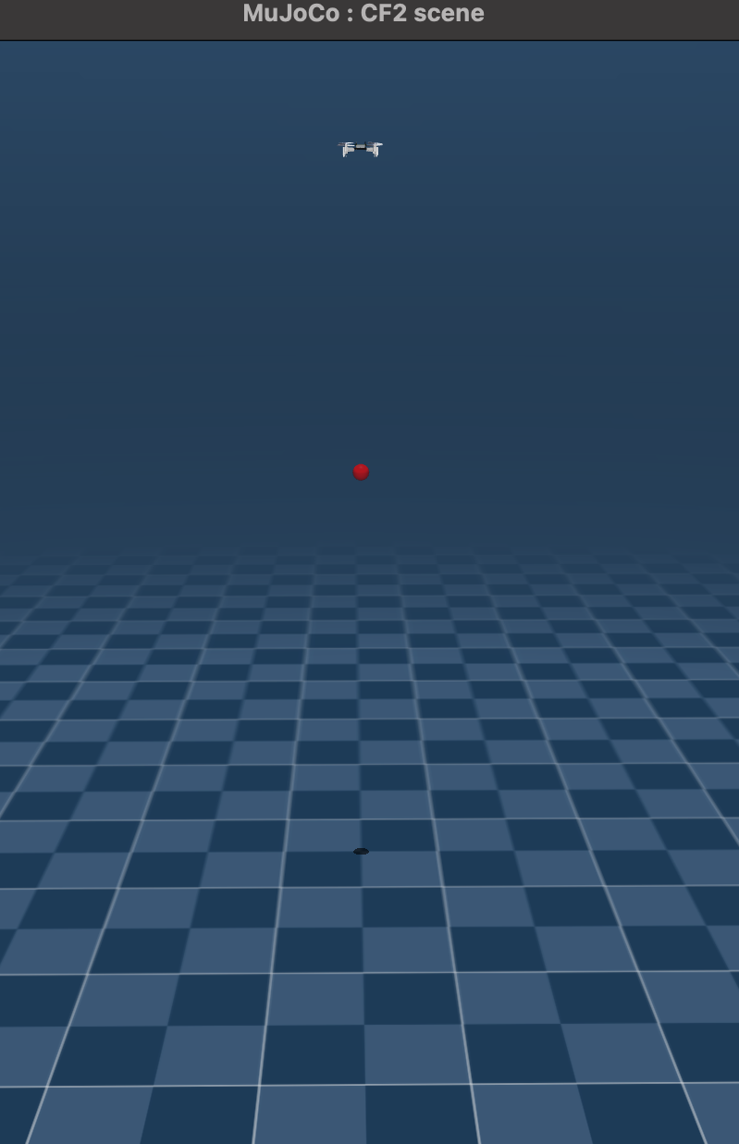
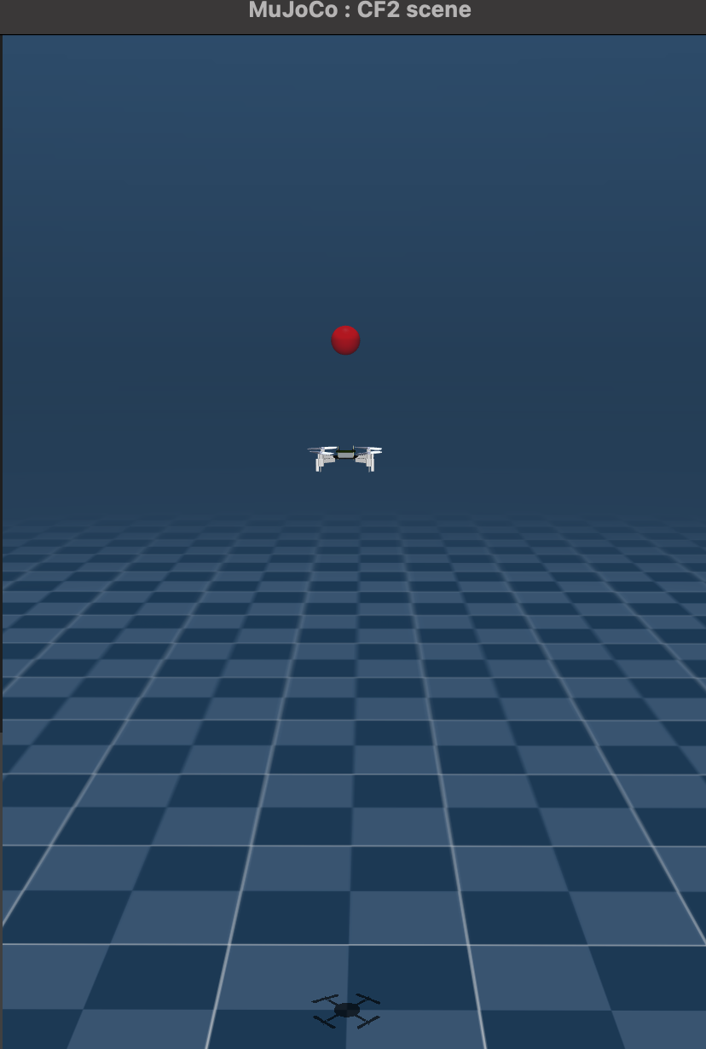
T = 1
T = 2
T = 3
T = 4
Current Goal: Hovering towards a target at [0, 0, 1] (thrust only)
Result: Oscillation about target (or gets stuck on ground / flies high)

Slide 6
Plan for the Next Two Weeks
Goals
  Learn a single drone to hover at a target in any [X, Y, Z]
    Perhaps hover at target T, then return to starting position and land
  Learn about MAPPO theory and implementation
Dependencies
  Researching / testing the parameters and current setup
    Need consistent behaviour convergence
    Need reduced oscillation

Slide 7
Roadmap Checkpoint
Week 2: Imperfect single agent hovering at target on Z axis
Week 4: Next milestone
Final deadline: Deliverables (e.g., report, demo, paper draft)
Note shifts in schedule here so I can track drift

Slide 8
Discussion Points / Questions
General feedback on the current setup (Main issue: Target Oscillation)
  Environment → Pure RL control (e.g. no thrust baseline)
    During training, drone initialized to random position on Z-axis [0, 0, Z]
    Reward based on distance improvement (reward += old distance - new distance)
    Episode termination based on N ~100 number of steps
  PPO-Clip
    Update policy every n ~1k steps, over N ~100k total timesteps
    Anneal learning rate linearly (fine-tune the policy, encourage exploration at start)
    Minibatches, KL-Divergence check, and Entropy bonus
  Plan
    Experiment with minor changes to the environment and/or policy
      I am working on a script to test different values across PPO / env parameters

Slide 9
Log Snapshot (Cumulative)
Date | Progress Summary | Next Steps | Notes
Sept. 16 | Set up MuJoCo sim; baseline PPO-Clip training | Refine current setup, explore MAPPO theory | Policy / env is current imperfect / inconsistent
Sept. 30

Slide 10
Week 2-4
Z and YZ Single-Agent Hover

Slide 11
MIRL LAB Honours Project Bi-Weekly Update
MARL Crazyflie
Michael O’Sullivan, Aydin Yalcinkaya
Using MARL to learn safe take-off and hover policies for Crazyflie drones
CrazyFlie, MuJuCo, Gymnasium, PyTorch

Slide 12
Progress Recap
Goal: Implementing MARL on Crazyflie drones for safe hovering and navigation
Progress
Base environment for training a single drone to hover at a target
Vectorized single agent PPO-Clip that interacts with the environment
  Runs 1 or more environments in parallel for better sampling
Engineered features to help the agent understand observation relationships

Slide 13
Progress Since Last Meeting
Vectorized environments: Agent can run multiple envs in parallel
  Using SB3 VecEnv → Agent uses batched observations and actions
Hyperparameters and training schedule: Adjusted based on testing
  E.g. now running ~1500 step episodes for 150 000 total steps
Feature engineering: Modifying base (pos/vel/rot) features to help the agent establish meaningful connections: ~100 features in obs space
  E.g. relative position to target, (squared) distance to target, some are more complex, e.g. direction to target in the drones local coordinate system (body→world rotation matrix @ direction vector)
  Tracking observation gradients during eval run to guide engineering
Results: Better sampling, less variant and more successful behaviour

Slide 14
Plan for the Next Two Weeks
Goals
  Learn a single drone to hover at a target in any [X, Y, Z]
    Perhaps hover at target T, then return to starting position and land
  Learn about MAPPO theory and implementation
Dependencies
  Currently, feature engineering has yielded the most improvement
    Experiment with other features, possibly adjust hyperparameters and training

Slide 15
Roadmap Checkpoint
Week 2: Imperfect single agent hovering at target on Z axis
Week 4: Successful [0, 0, Z] hover, imperfect [0, Y, Z] hover
Week 6: Next milestone
Final deadline: Deliverables (e.g., report, demo, paper draft)
  Early December
Shifts in schedule
  Had planned to get [X, Y, Z] hovering working this week, so slightly behind (although this was an ambitious goal)

Slide 16
Discussion Points / Questions
Feature engineering discussion
  As I understand it, feature engineering will speed up the learning process and reduce training time
  Comparable projects (Champion-level drone racing using deep reinforcement learning) use a more basic observation space
    Pos/Vel & Rotation matrix (15) + Relative pos of next quadrant (12) + prev action (4) → Total 31
    More rigorous training: 100 parallel envs, 100 million steps
    Us: 24 envs, 3.6 million steps (24 envs, 150000 steps per)
  Is our approach (~100 features) reasonable?
    Implications for running on actual drones (e.g. feature noise)?

Slide 17
Log Snapshot (Cumulative)
Date | Progress Summary | Next Steps | Notes
Sept. 16 | Set up MuJoCo sim; baseline PPO-Clip training | Refine current setup, explore MAPPO theory | Policy / env is current imperfect / inconsistent
Sept. 30 | Successful Z hover. Semi-successful YZ hover | Refine YZ hover and move to XYZ, explore MAPPO theory

Slide 18
Week 4-6
XYZ hover within small ranges for a single agent

Slide 19
MIRL LAB Honours Project Bi-Weekly Update
MARL Crazyflie
Michael O’Sullivan, Aydin Yalcinkaya
Using MARL to learn safe take-off and hover policies for Crazyflie drones
CrazyFlie, MuJuCo, Gymnasium, PyTorch

Slide 20
Progress Recap
Goal: Implementing MARL on Crazyflie drones for safe hovering and navigation
Progress
Base environment for training a single drone to hover at a target
Vectorized single agent PPO-Clip that interacts with the environment
  Runs 1 or more environments in parallel for better sampling
Engineered features to help the agent understand observation relationships
Single agent XYZ hover within small ranges ~1m

Slide 21
Progress Since Last Meeting
New reward system
  R = survival + w1 * distance_improvement + w2 * target_proximity
Taking 10 MuJoCo physics steps per 1 env step
  Previously, env / MuJoCo steps were one-to-one
  The observation delay allows less reactive commands (roll/pitch/yaw) to have a more visible effect to the agent, and simulates actual control-observation delay
Curriculum of gradually increasing difficulty
  During training, gradually scale up the drone’s random initial position, rotation, and velocities
Results: Successful XYZ hover within ~1m (crashes when further)

Slide 22
Plan for the Next Two Weeks
Goals
  Extend XYZ hover to greater distances
  Learn about MAPPO theory, begin implementation
Dependencies
  Research dynamic XYZ hover strategies and MAPPO

Slide 23
Roadmap Checkpoint
Week 2: Imperfect single agent hovering at target on Z axis
Week 4: Successful [0, 0, Z] hover, imperfect [0, Y, Z] hover
Week 6: Successful XYZ hover within small ranges
Week 8: ___
Final deadline: Deliverables (e.g., report, demo, paper draft)
  Early December
Shifts in schedule
  Relatively on track, hoping to get better ranges for XYZ and a baseline MAPPO implementation by next meeting

Slide 24
Discussion Points / Questions
Extending to any range in XYZ?
  Currently, the curriculum scales the initial starting position up to 0.5m (10 curriculum stages, start at 0.05m, +0.05m each stage)
    Extending the curriculum has helped, but this linearly scales the training time and does not generalize to any XYZ
    Currently, successful XYZ hover within ~1m takes ~15 minutes
      8 parallel environments, 600k steps per env, 4.6 million total
  Strategies?
    Break up large journeys + pathfinding between checkpoints?
    Reshape rewards and/or observations for longer journeys?
      E.g. rewarding stable flight throughout entire journey might help drone navigate to far targets without crashing (?)

Slide 25
Log Snapshot (Cumulative)
Date | Progress Summary | Next Steps | Notes
Sept. 16 | Set up MuJoCo sim; baseline PPO-Clip training | Refine current setup, explore MAPPO theory | Policy / env is current imperfect / inconsistent
Sept. 30 | Successful Z hover. Semi-successful YZ hover | Refine YZ hover and move to XYZ, explore MAPPO theory
Oct. 14 | Small XYZ hover | Full XYZ hover and MAPPO implementation

Slide 26
Week 6-8
XYZ hover within any range + Baseline MARL implementation

Slide 27
MIRL LAB Honours Project Bi-Weekly Update
MARL Crazyflie
Michael O’Sullivan, Aydin Yalcinkaya
Using MARL to learn safe take-off and hover policies for Crazyflie drones
CrazyFlie, MuJuCo, Gymnasium, PyTorch

Slide 28
Progress Recap
Goal: Implementing MARL on Crazyflie drones for safe hovering and navigation
Progress
Base environment for training a single drone to hover at a target
Vectorized single agent PPO-Clip that interacts with the environment
  Runs 1 or more environments in parallel for better sampling
Engineered features to help the agent understand observation relationships
Single agent XYZ hover within most ranges (high success rate, not perfect)
Baseline MAPPO implementation with sparse success rates

Slide 29
Progress Since Last Meeting
MAPPO implementation
  Centralized critic (sees all obs), Decentralized actors (see their obs)
Multi-agent rewards
  -n1 for drone collision (terminal), -n2 for proximity to other drone(s)
New training setup for single/multi drones
  No curriculum, sampling from normal distribution for pos/quat/vel
Results: Successful single XYZ hover within most* XYZ (tested ~7m)
  Multi-agent hover rarely truncates (succeeds), drones often hover about the target for a while before one of the collides/crashes
  Any XYZ success largely due to “normalizing” relative pos to target
    Feature: Relative pos in body coordinates / initial distance to target

Slide 30
Progress Since Last Meeting (cont.)
Domain Randomization
  Adding noise to sensor readings like position, orientation, velocity
  Adding latency to sensor inputs, occasionally dropping readings
  Still need to implement accurate polling rate

Slide 31
Plan for the Next Two Weeks
Goals
  Successful MARL for 2 drones (hovering at a target without colliding)
    Possibly adding / testing with domain randomization as well
  Prepare to test on actual drones
    Maybe test single-agent hover on actual drone
Dependencies
  None

Slide 32
Roadmap Checkpoint
Week 2: Imperfect single agent hovering at target on Z axis
Week 4: Successful [0, 0, Z] hover, imperfect [0, Y, Z] hover
Week 6: Successful XYZ hover within small ranges
Week 8: Successful XYZ hover within most ranges, baseline MARL
Week 10: …
Final deadline: Deliverables (e.g., report, demo, paper draft)
  Early December
Shifts in schedule
  On track

Slide 33
Projected Progress for Final Meeting
Now (end of October)
  In simulation, getting semi-successful multi-agent hover (getting successful hover might just be a compute issue)
Final meeting (end of November)
  Successful multi-agent (2 drones) hover at a target in XYZ in simulation → Testing (and possibly success) on 2 real drones

Slide 34
Discussion Points / Questions
Testing on actual drones
  Booking time slots (how / what is the setup like)?
  Safety considerations
    What kind of fallbacks should we program into the agent?
      E.g. if pos/rot/vel > n → Apply neutral hover control?
      Physical safety constraints e.g. tether to drone?
    Landing → Run for t seconds then apply sub-neutral thrust?
      E.g. after 10 seconds, apply (hover thrust - 0.01)?
Multi-XYZ success → Improvement suggestions?
  Any other suggestions / ideas?
  Currently has ~50% success rate at best, see next slides

Slide 35
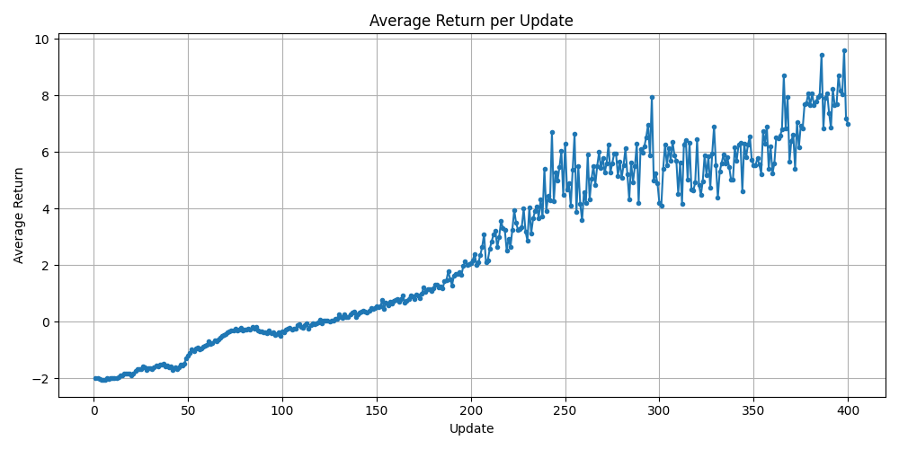
Multi-Agent training, 40 envs, 600k steps per → ~2hrs

Slide 36
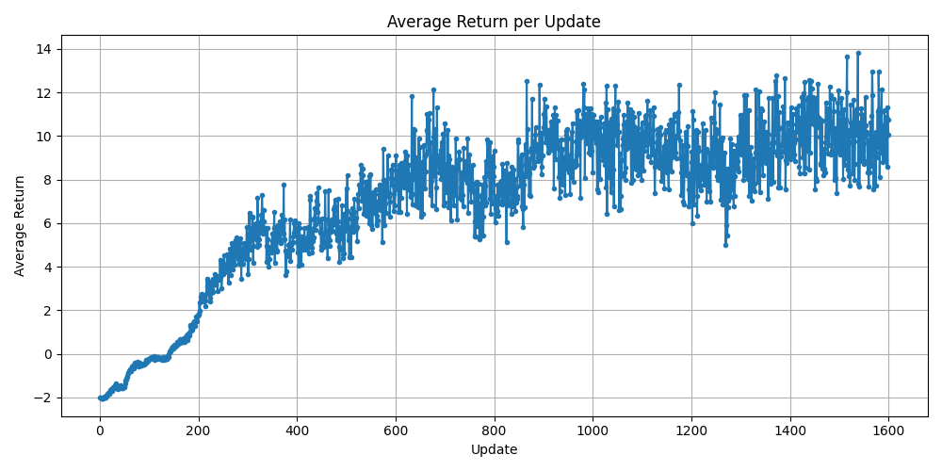
Multi-Agent training, 40 envs, 2.4mil steps per → ~8hrs

Slide 37
Log Snapshot (Cumulative)
Date | Progress Summary | Next Steps | Notes
Sept. 16 | Set up MuJoCo sim; baseline PPO-Clip training | Refine current setup, explore MAPPO theory | Policy / env is current imperfect / inconsistent
Sept. 30 | Successful Z hover. Semi-successful YZ hover | Refine YZ hover and move to XYZ, explore MAPPO theory
Oct. 14 | Small XYZ hover | Full XYZ hover and MAPPO implementation
Oct 28 | Single + Multi XYZ hover | Better multi-XYZ hover, testing on actual drones

Slide 38
Week 8-10
XYZ hover using MuJoCo MJX GPU training

Slide 39
MIRL LAB Honours Project Bi-Weekly Update
MARL Crazyflie
Michael O’Sullivan, Aydin Yalcinkaya
Using MARL to learn safe take-off and hover policies for Crazyflie drones
CrazyFlie, MuJuCo, Gymnasium, PyTorch

Slide 40
Progress Recap
Goal: Implementing MARL on Crazyflie drones for safe hovering and navigation
Progress
Re-implement environment using MuJoCo MJX to allow for GPU training
  Done via MuJoCo playground + Brax + Jax
  Running on Google Colab (Jax GPU is built for Linux)
    Not easily ran from Windows and can’t run from mac
  Motivation: Semi-successful multi-agent training was taking ~8 hours
    Difficult to iterate upon and experiment with, need faster training
    Also possible that successful MARL simply requires more compute
Put together model -> hardware runner file

Slide 41
Progress Since Last Meeting
Create Google Collab notebook for MuJoCo MJX + Jax
  Setup environment for n drones (can run with 1 or 2 right now)
Results
  Very stable XYZ hover (single drone)
    2048 envs, 75 million steps ~ 20 minutes in Collab
    Minimal obs → High compute reduces need for engineered features
      Pos, Rot matrix, Vel, Ang vel + Rel target pos in body & vel in body & act history
  Unsuccessful 2-drone hover for now (drones thrust then fall)
    Tested with 150 million steps, will investigate more
    Multi-agent approach uses centralized PPO instead of MAPPO (basically single-agent where a “dispatcher” sees both drone obs and controls both)
      Using Brax for training (Jax wrapper) which does not support MAPPO (in which agents act on their individual obs with a centralized critic)

Slide 42
Plan for the Next Two Weeks
Goals
  Get successful 2-drone hover using MuJoCo MJX
  Prepare to test on actual drones (cf2 API + safety constraints)
  Test on actual drones
    Maybe test single-agent hover on actual drone if multi-agent not successful
Dependencies
  Access to physical drones
    Link to WHMIS training that needs to be taken

Slide 43
Roadmap Checkpoint
Week 2: Imperfect single agent hovering at target on Z axis
Week 4: Successful [0, 0, Z] hover, imperfect [0, Y, Z] hover
Week 6: Successful XYZ hover within small ranges
Week 8: Successful XYZ hover within most ranges, baseline MARL
Week 10: Successful single XYZ hover using MJX, MARL not there yet
Week 12: __
Final deadline: Deliverables (e.g., report, demo, paper draft)
  Early December
Shifts in schedule
  On track

Slide 44
Log Snapshot (Cumulative)
Date | Progress Summary | Next Steps | Notes
Sept. 16 | Set up MuJoCo sim; baseline PPO-Clip training | Refine current setup, explore MAPPO theory | Policy / env is current imperfect / inconsistent
Sept. 30 | Successful Z hover. Semi-successful YZ hover | Refine YZ hover and move to XYZ, explore MAPPO theory
Oct. 14 | Small XYZ hover | Full XYZ hover and MAPPO implementation
Oct 28 | Single + Multi XYZ hover | Better multi-XYZ hover, testing on actual drones

Slide 45
Log Snapshot (Cumulative)
Date | Progress Summary | Next Steps | Notes
Nov. 11 | Pivoted to MJX for more compute-intense training | Fix 2 agent, prepare for testing on hardware

Slide 46
Week 10-12
Successful 2-drone XYZ hover using MuJoCo Playground + Jax for MAPPO GPU training

Slide 47
MIRL LAB Honours Project Bi-Weekly Update
MARL Crazyflie
Michael O’Sullivan, Aydin Yalcinkaya
Using MARL to learn safe take-off and hover policies for Crazyflie drones
CrazyFlie, MuJuCo, Gymnasium, PyTorch

Slide 48
Progress Recap
Goal: Implementing MARL on Crazyflie drones for safe hovering and navigation
Progress
Gym + MuJoCo → Very successful single XYZ, not so much with multi
  Long training times, looking back the env needed adjustment too
Google notebook for Jax training using MuJoCo playground
  Single agent training with Brax PPO (baseline test)
  Multi-agent training (2 drones) with custom Jax MAPPO training
  → Very stable and consistently successful results

Slide 49
Progress Since Last Meeting
Created custom MAPPO training in Google Collab notebook using Jax
  JIT compilation, PRNG key (seed), Jax utilities e.g. jax.lax.scan…
  JIT training step (update) → Run training in Python for loop
Agents see self-observations + relative pos of other drones
  Training: Random target & random drone state (pos/vel…) near target
    2048 env, 128-step rollout, 1000 updates → ~250mil steps in ~50min
Results → Successful model (stored as Flax training state w/ NN params)
  Tested ~20 targets on varying XYZ (+/- ~7m) → No crashes or collisions
    Drones seem to maintain a relatively fixed distance to one another when at target (e.g. one at target, other nearby, or both slightly offset)
      Remain this way until the end of the episode (step limit)

Slide 50
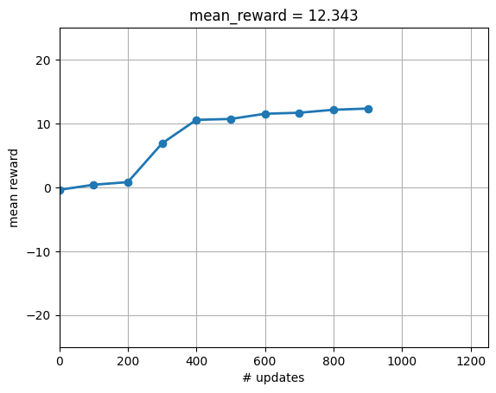

Slide 51
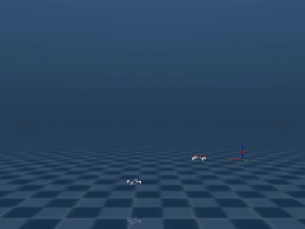

Slide 52
Plan for the Next Two Weeks
Goals
  Domain randomization (I believe Playground has built-in support)
  Prepare to and test on actual drones (prepare cf2 API for flax model)
    Safety constraints + landing post-episode / time-limit
  Begin work on final presentation + report
Dependencies
  Access to physical drones

Slide 53
Roadmap Checkpoint
Week 2: Imperfect single agent hovering at target on Z axis
Week 4: Successful [0, 0, Z] hover, imperfect [0, Y, Z] hover
Week 6: Successful XYZ hover within small ranges
Week 8: Successful XYZ hover within most ranges, baseline MARL
Week 10: Successful single XYZ hover using MJX, MARL not there yet
Week 12: Successful 2-drone XYZ hover using MJX + Jax MAPPO
Week 14: __
Final deadline: Deliverables (e.g., report, demo, paper draft)
  Early-Mid December
Shifts in schedule
  On track (hopefully get real drone testing in)

Slide 54
Log Snapshot (Cumulative)
Date | Progress Summary | Next Steps | Notes
Sept. 16 | Set up MuJoCo sim; baseline PPO-Clip training | Refine current setup, explore MAPPO theory | Policy / env is current imperfect / inconsistent
Sept. 30 | Successful Z hover. Semi-successful YZ hover | Refine YZ hover and move to XYZ, explore MAPPO theory
Oct. 14 | Small XYZ hover | Full XYZ hover and MAPPO implementation
Oct 28 | Single + Multi XYZ hover | Better multi-XYZ hover, testing on actual drones

Slide 55
Log Snapshot (Cumulative)
Date | Progress Summary | Next Steps | Notes
Nov. 11 | Pivoted to MJX for more compute-intense training | Fix 2 agent, prepare for testing on hardware
Nov 25 | Successfully 2-drone MJX + Jax training | Prepare to test and test on real drones

